Slide 1
Super Resolution of occluded or unclear faces
using Generative Adversarial Networks
Akhil Nair | Mounica Subramani | Mrinal Soni | SuRui Yang

Slide 2
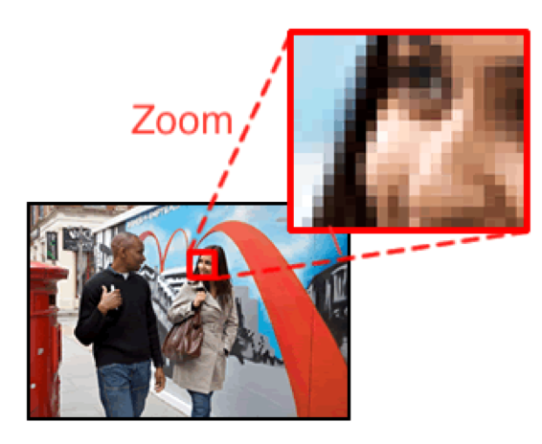
Introduction
Challenge: Inability to capture perceptually satisfying features in an image.
Goal: Reconstruct high quality images, ensuring perceptual quality is preserved.
PROBLEM STATEMENT:
Generate a super resolution image from Generator and feed it to Discriminator to classify it.
Improve the existing implementation of GAN to get better super resolution images out of generator.
Low-resolution
Super-resolution
High-resolution
low-resolution
high-resolution
Notes:
Super resolution of unclear or occluded faces using generative adversarial networks.
I will give a brief recap of the project.
Image or video data contain plenty of information and have wide range of applications in the field of research and development.
Many applications require zooming of a specific area in the image where HR becomes essential eg. tumors diagnosis, visual surveillance etc
No matter how well an upscaling algo performs, there will be some amount of info lost and drop in image quality.
An efficient fix for certain situation deserves high attention.
Estimating a high-resolution image from its low-resolution counterpart is referred to as super-resolution .
In this project, we aim to explore image super-resolution using generative adversarial networks, trying to minimize detail lost during the upscaling procedure.
Problem statement : In a nutshell, we are trying to generate a SR image from generator and then feed it to discriminator along with original HR images to classify them.

Slide 3
Overview
GAN applies a deep network in combination with an adversary network to generate new data.
GAN generator (deep neural net) creates fake data.
Discriminator (another deep neural net) is a classifier model.
Training GAN.
Notes:
Adversarial : two deep neural nets, they are generator model and discriminator model.
The generator takes in low resolution image as input and learns all the features from the low resolution image and tries to create a possible super resolution image. On repetitive training and learning of the generator, it comes close to producing a good super resolution image.
This generated fake SR image is fed into the discriminator alongside a stream of original HR Image taken from the actual, ground-truth dataset.
The discriminator is a normal (and well understood) classification model.
The discriminator takes in both HR and SR image and returns probabilities, a number between 0 and 1, with 1 representing real and 0 representing fake.

Slide 4
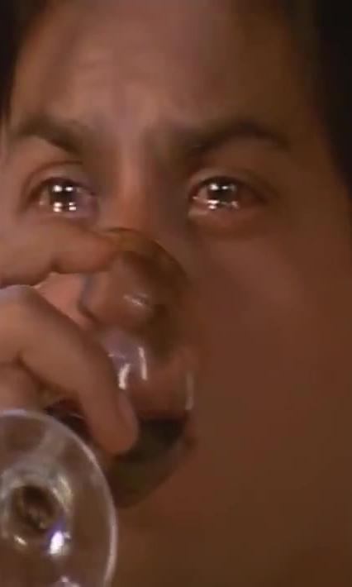
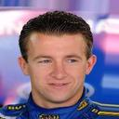

Dataset
The CelebA dataset consists of 202,599 face images of 10,177 unique identities
Images are frontal images with less occlusion and mostly clear faces
To avoid bias we would train our model on a second dataset Indian Movie Face Database
The dataset contains 34512 images of 100 actors collected from 100 videos
Notes:
Chances of creating bias in the model is high
To avoid bias movie face database
Images have a lot of diversity in pose, expression, occlusion, resolution

Slide 5
Generative Adversarial Network
Network Functions: Batch Normalization
Why？
A common failure mode observed in GANs is that the generator and discriminator from collapsing all samples to a single point
How？
Normalize the input to each unit to have zero mean and unit variance
Effect
Deal with training problems that arise due to poor initialization and helps gradient flow in deeper models.
Notice
Not applying batch norm to the final output layer, otherwise resulted in unstable accuracy

Slide 6
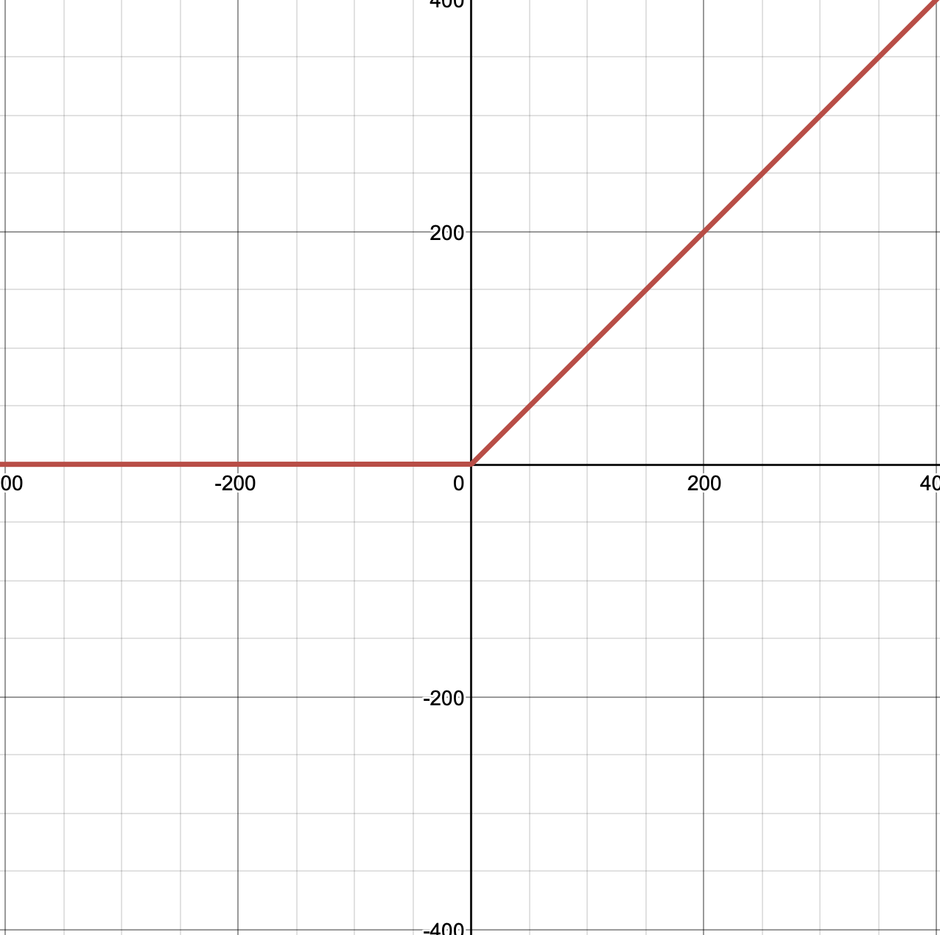
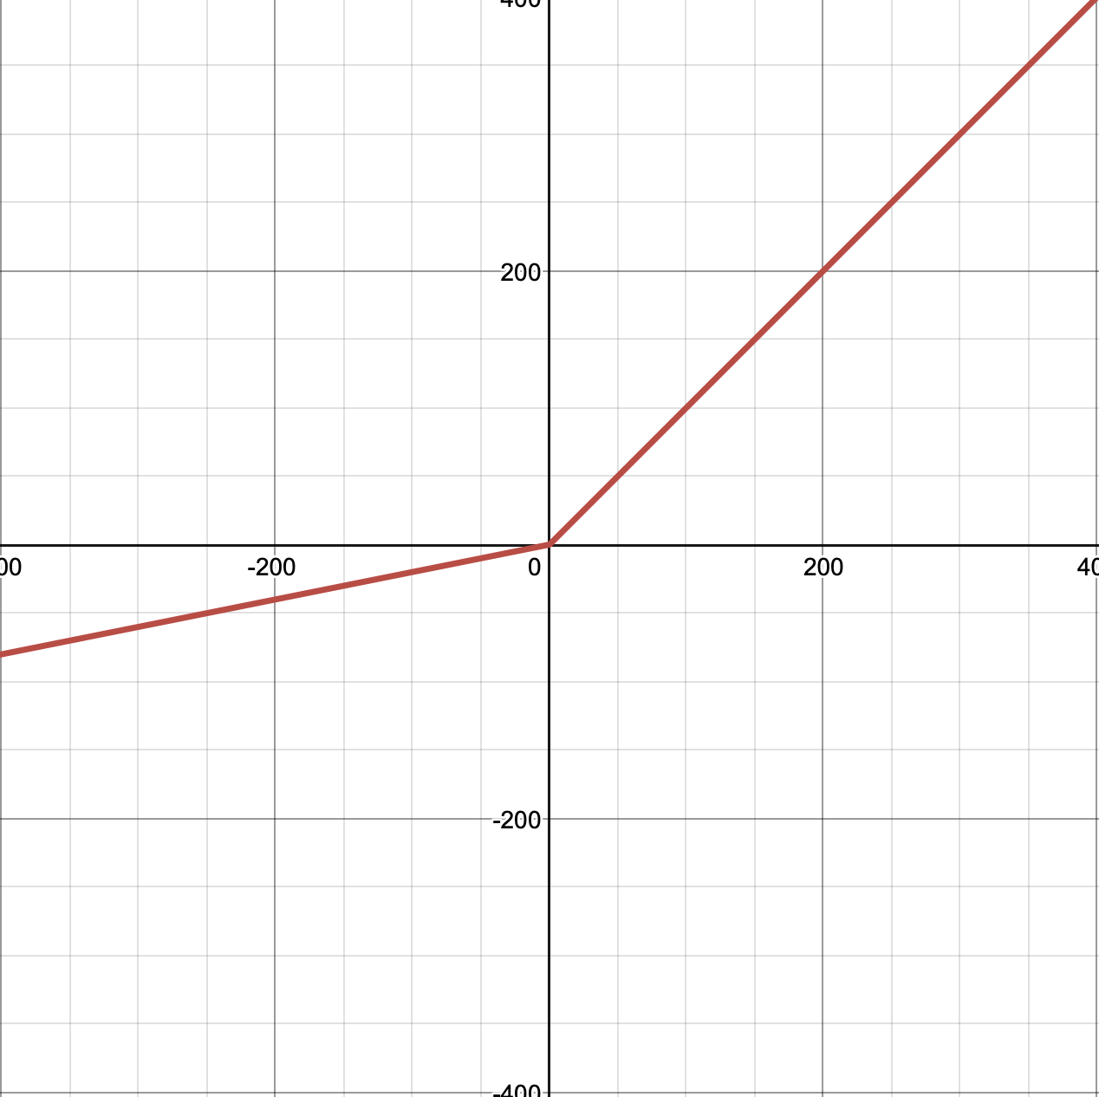
Generative Adversarial Network
Network Functions: Leaky ReLU & Parametric ReLU
why?
The motivation of L/PReLU is to avoid zero gradients, which
fixes the “dying ReLU” problem
Both speed up training
Difference
PReLU adaptively learns the parameters of the rectifiers,
and improves accuracy at negligible
extra computational cost
If a is a small and fixed value, PReLU
becomes the Leaky ReLU
f(y)=y
f(y)=y
f(y)=0
f(y)=ay
ReLU
Parametric ReLU

Slide 7
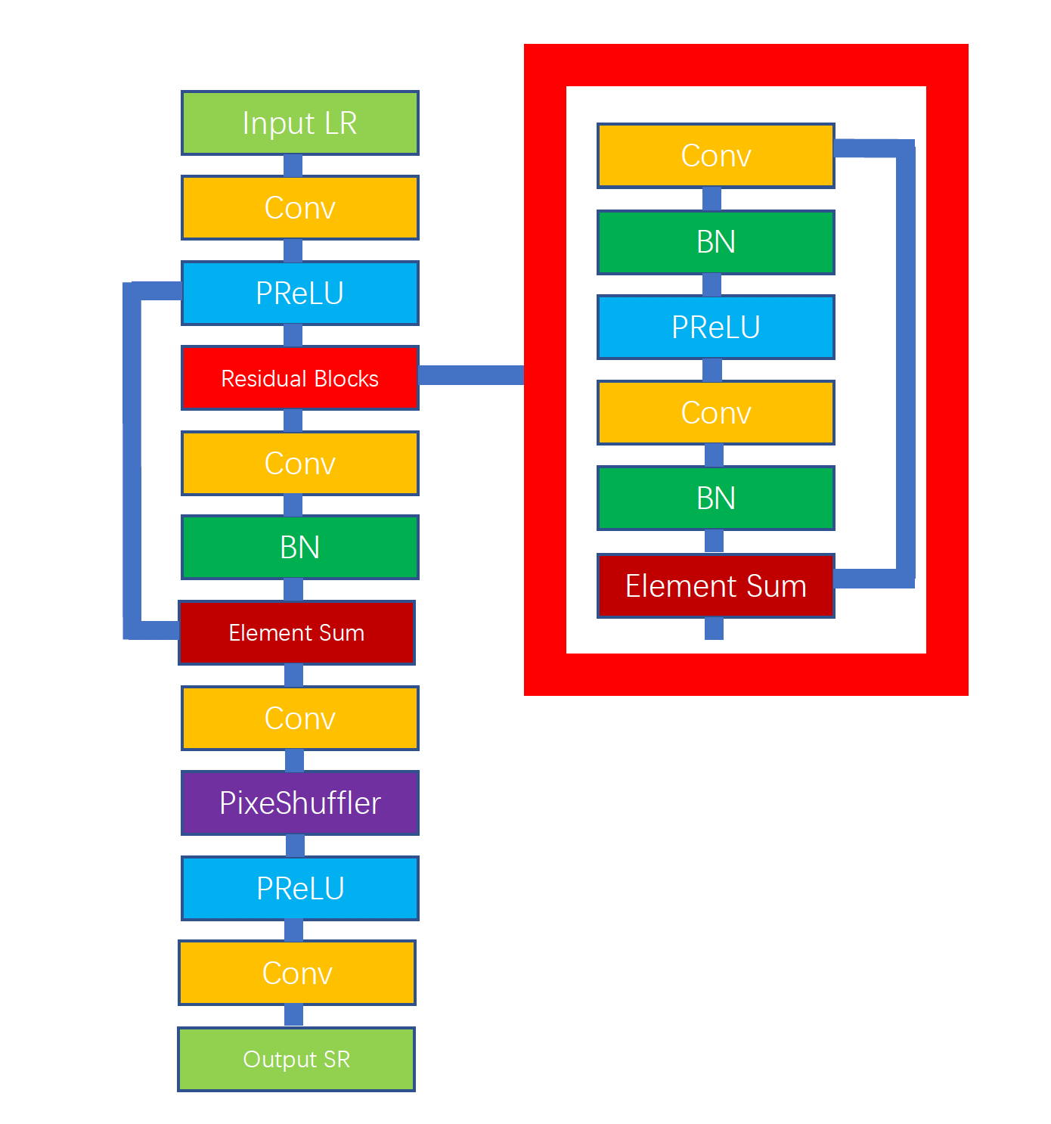
Generator
Skip connection
Feed deeper network by previous
Layer, avoiding vanishing gradient
PixeShuffler
Upsample input by factor of 2,
Making sure final output dimension
Skip connection
Skip connection

Slide 8
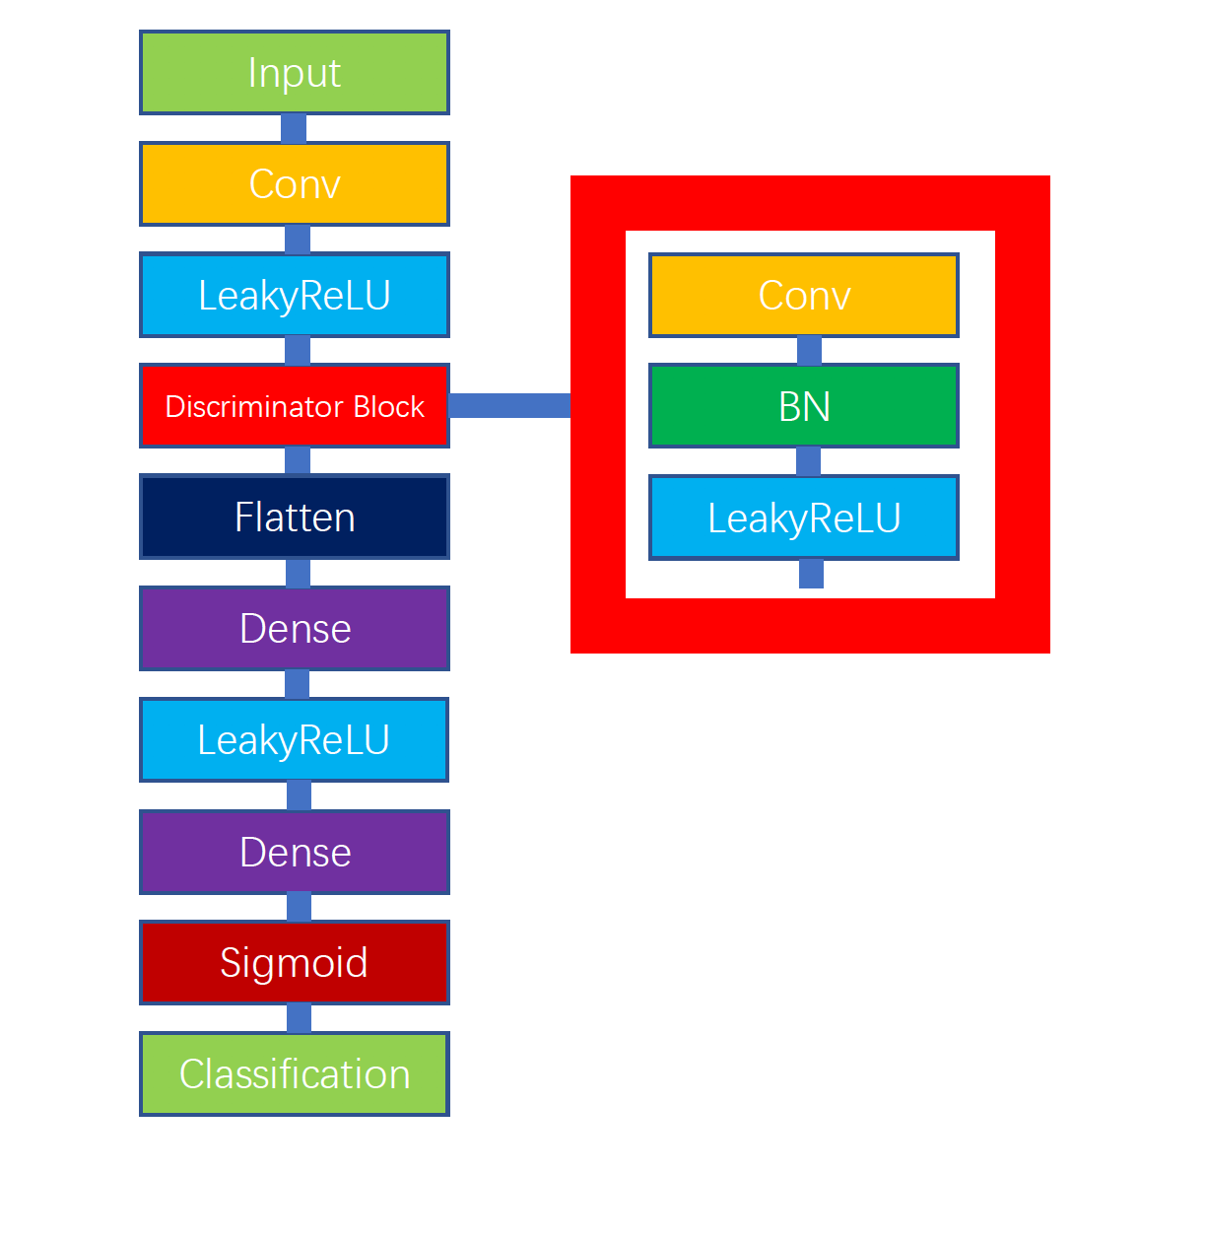
Discriminator
Flatten
Break the spatial structure of the data and
create a single long feature vector to be
used by the dense layer
Dense layer
Find patterns for discriminating in pixel
values that given as input

Slide 9
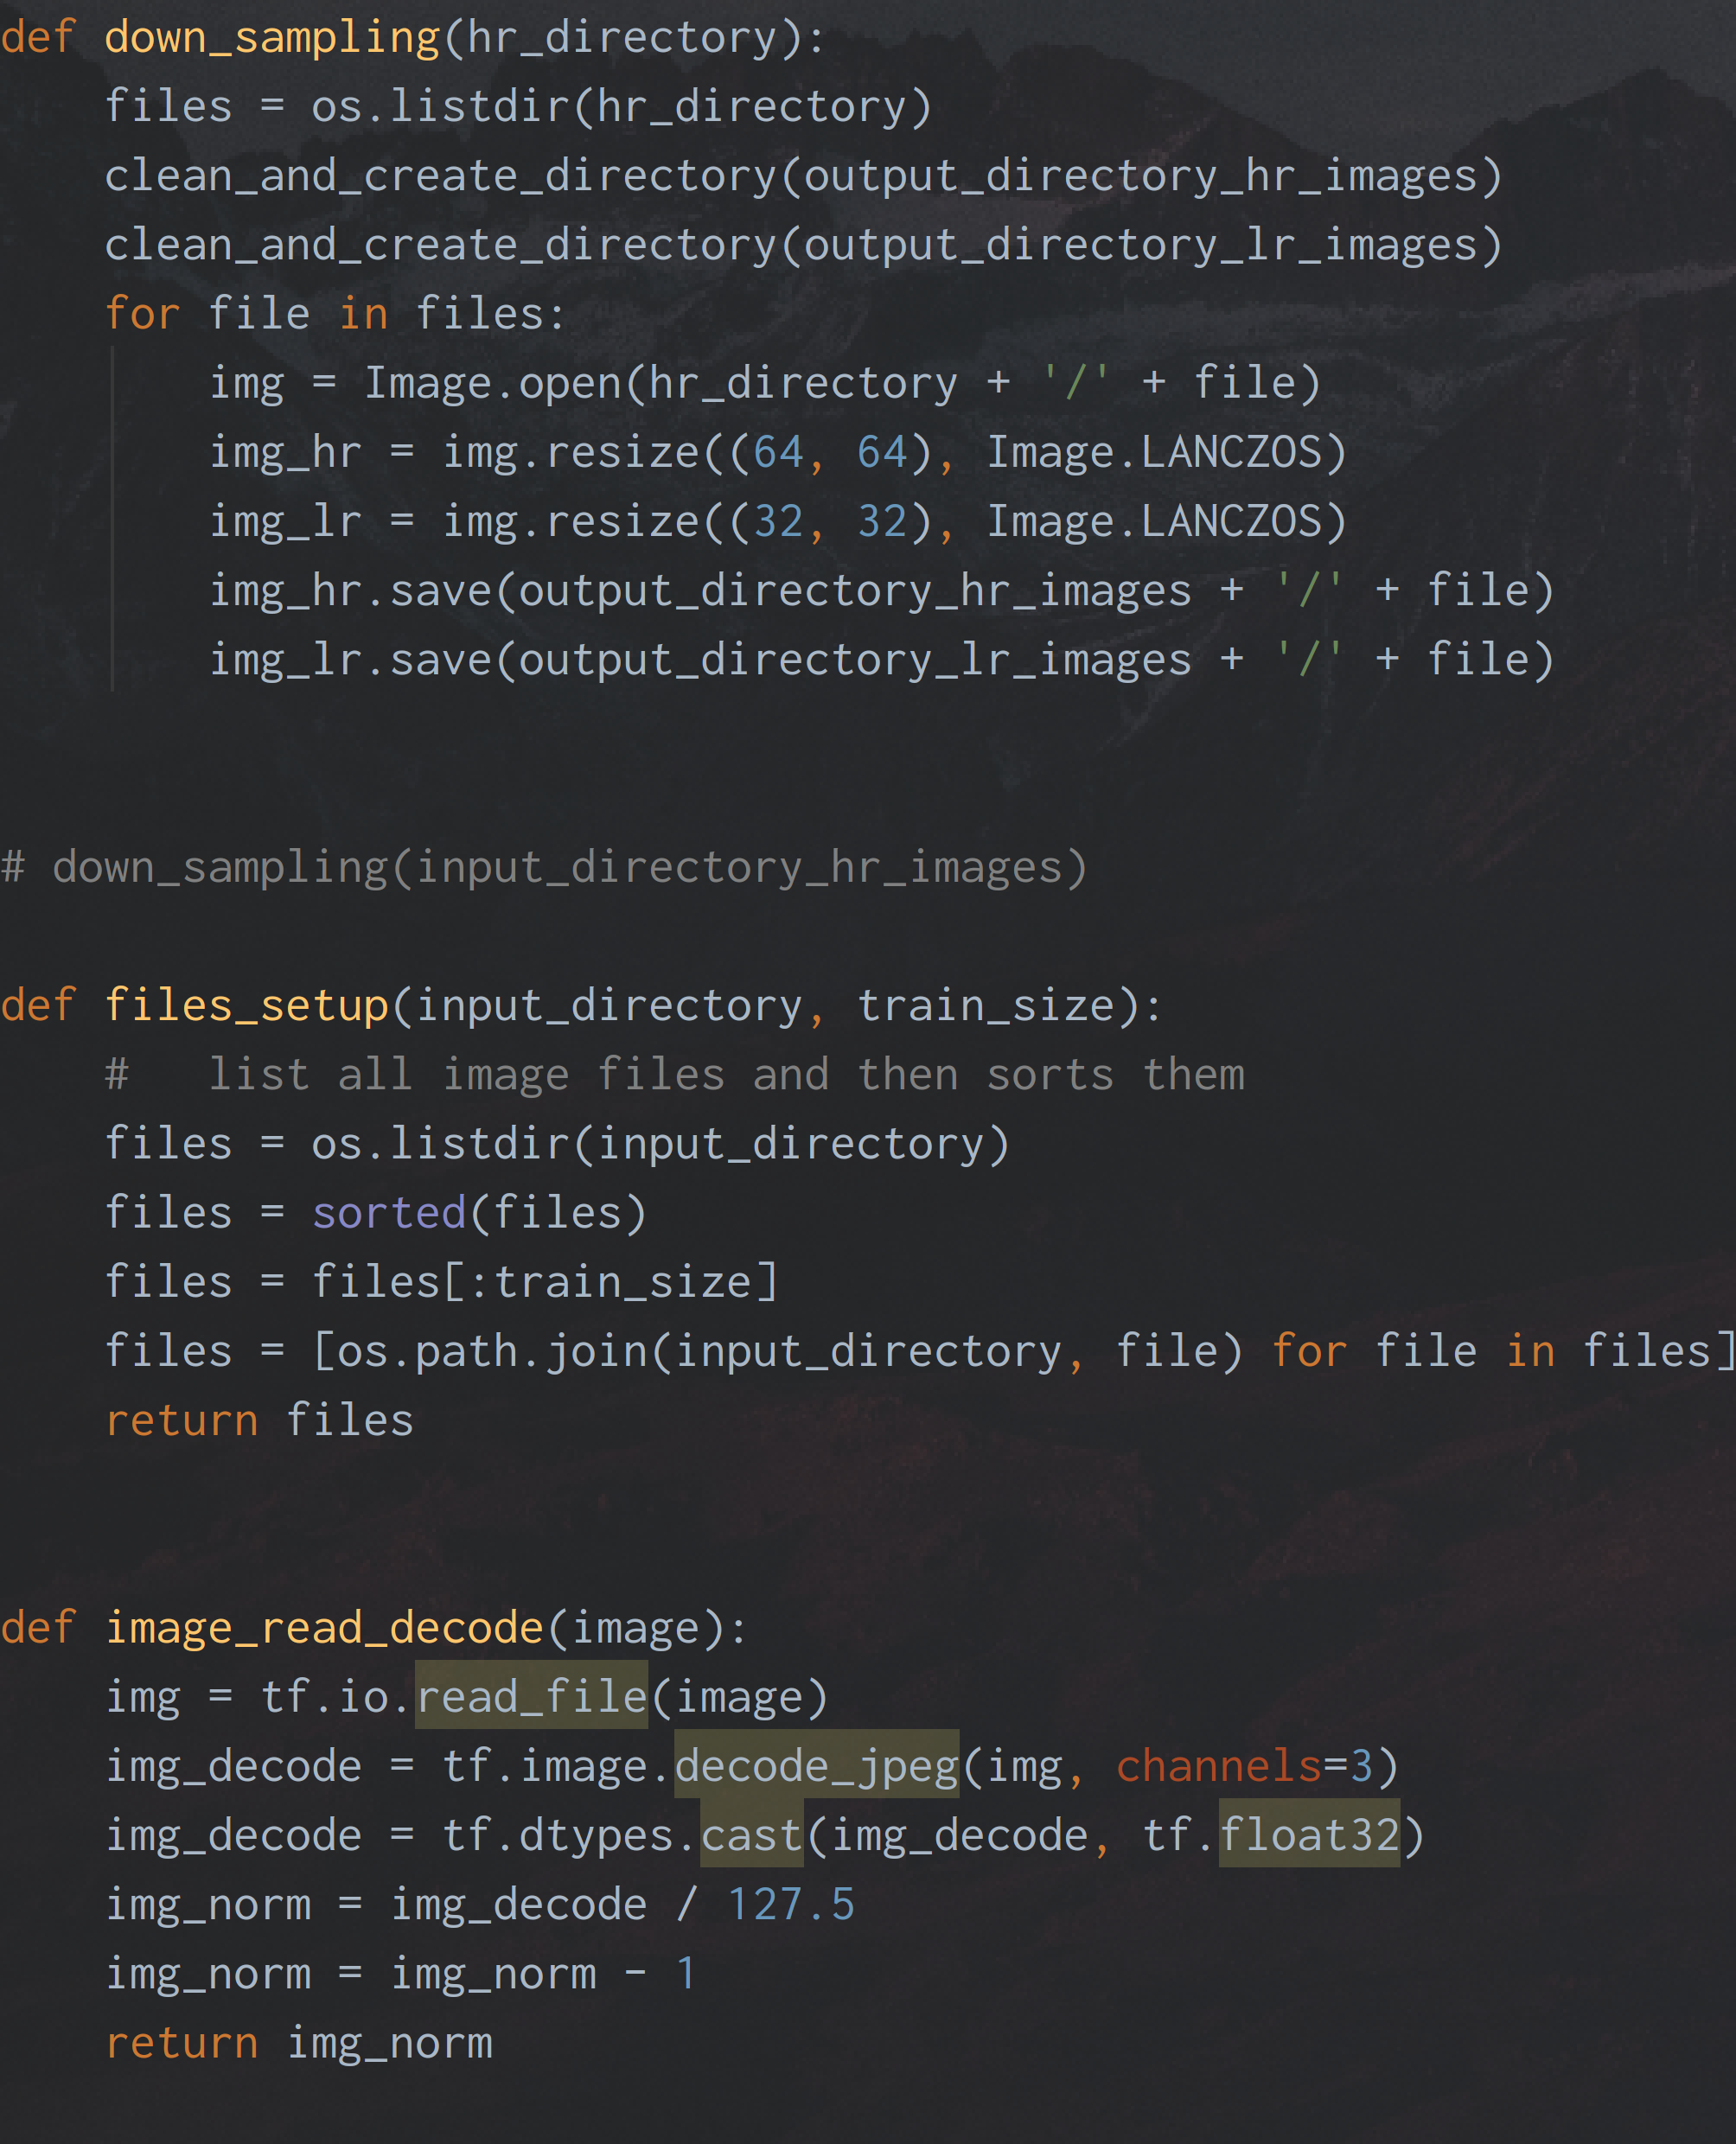
Preprocessing
Downsampling
Normalization
Batching
Feed input to tensorflow(tensorflow)

Slide 10
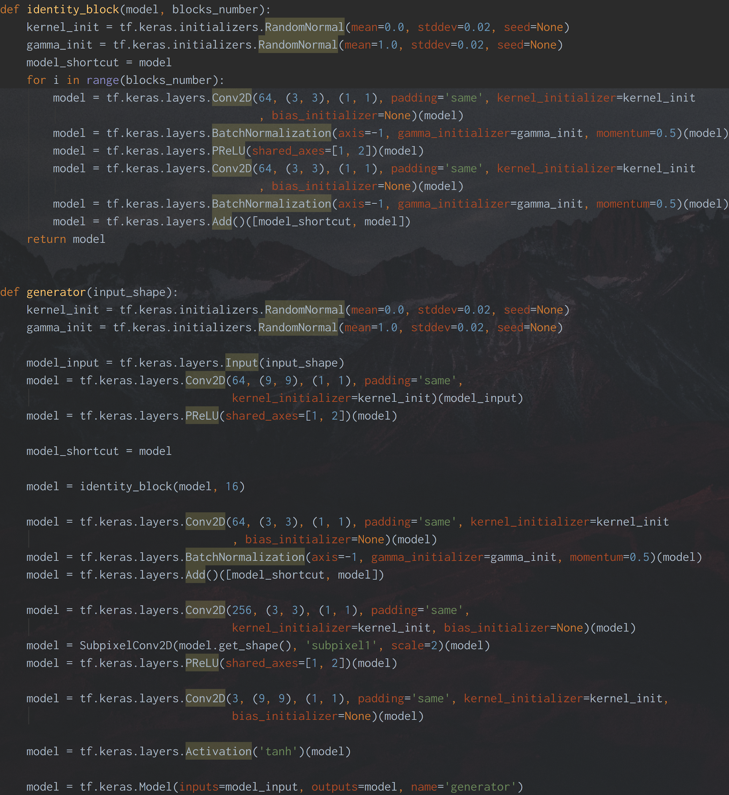
Generator Model Building
1.4M Trainable Parameters
Model fed with low resolution Images

Slide 11
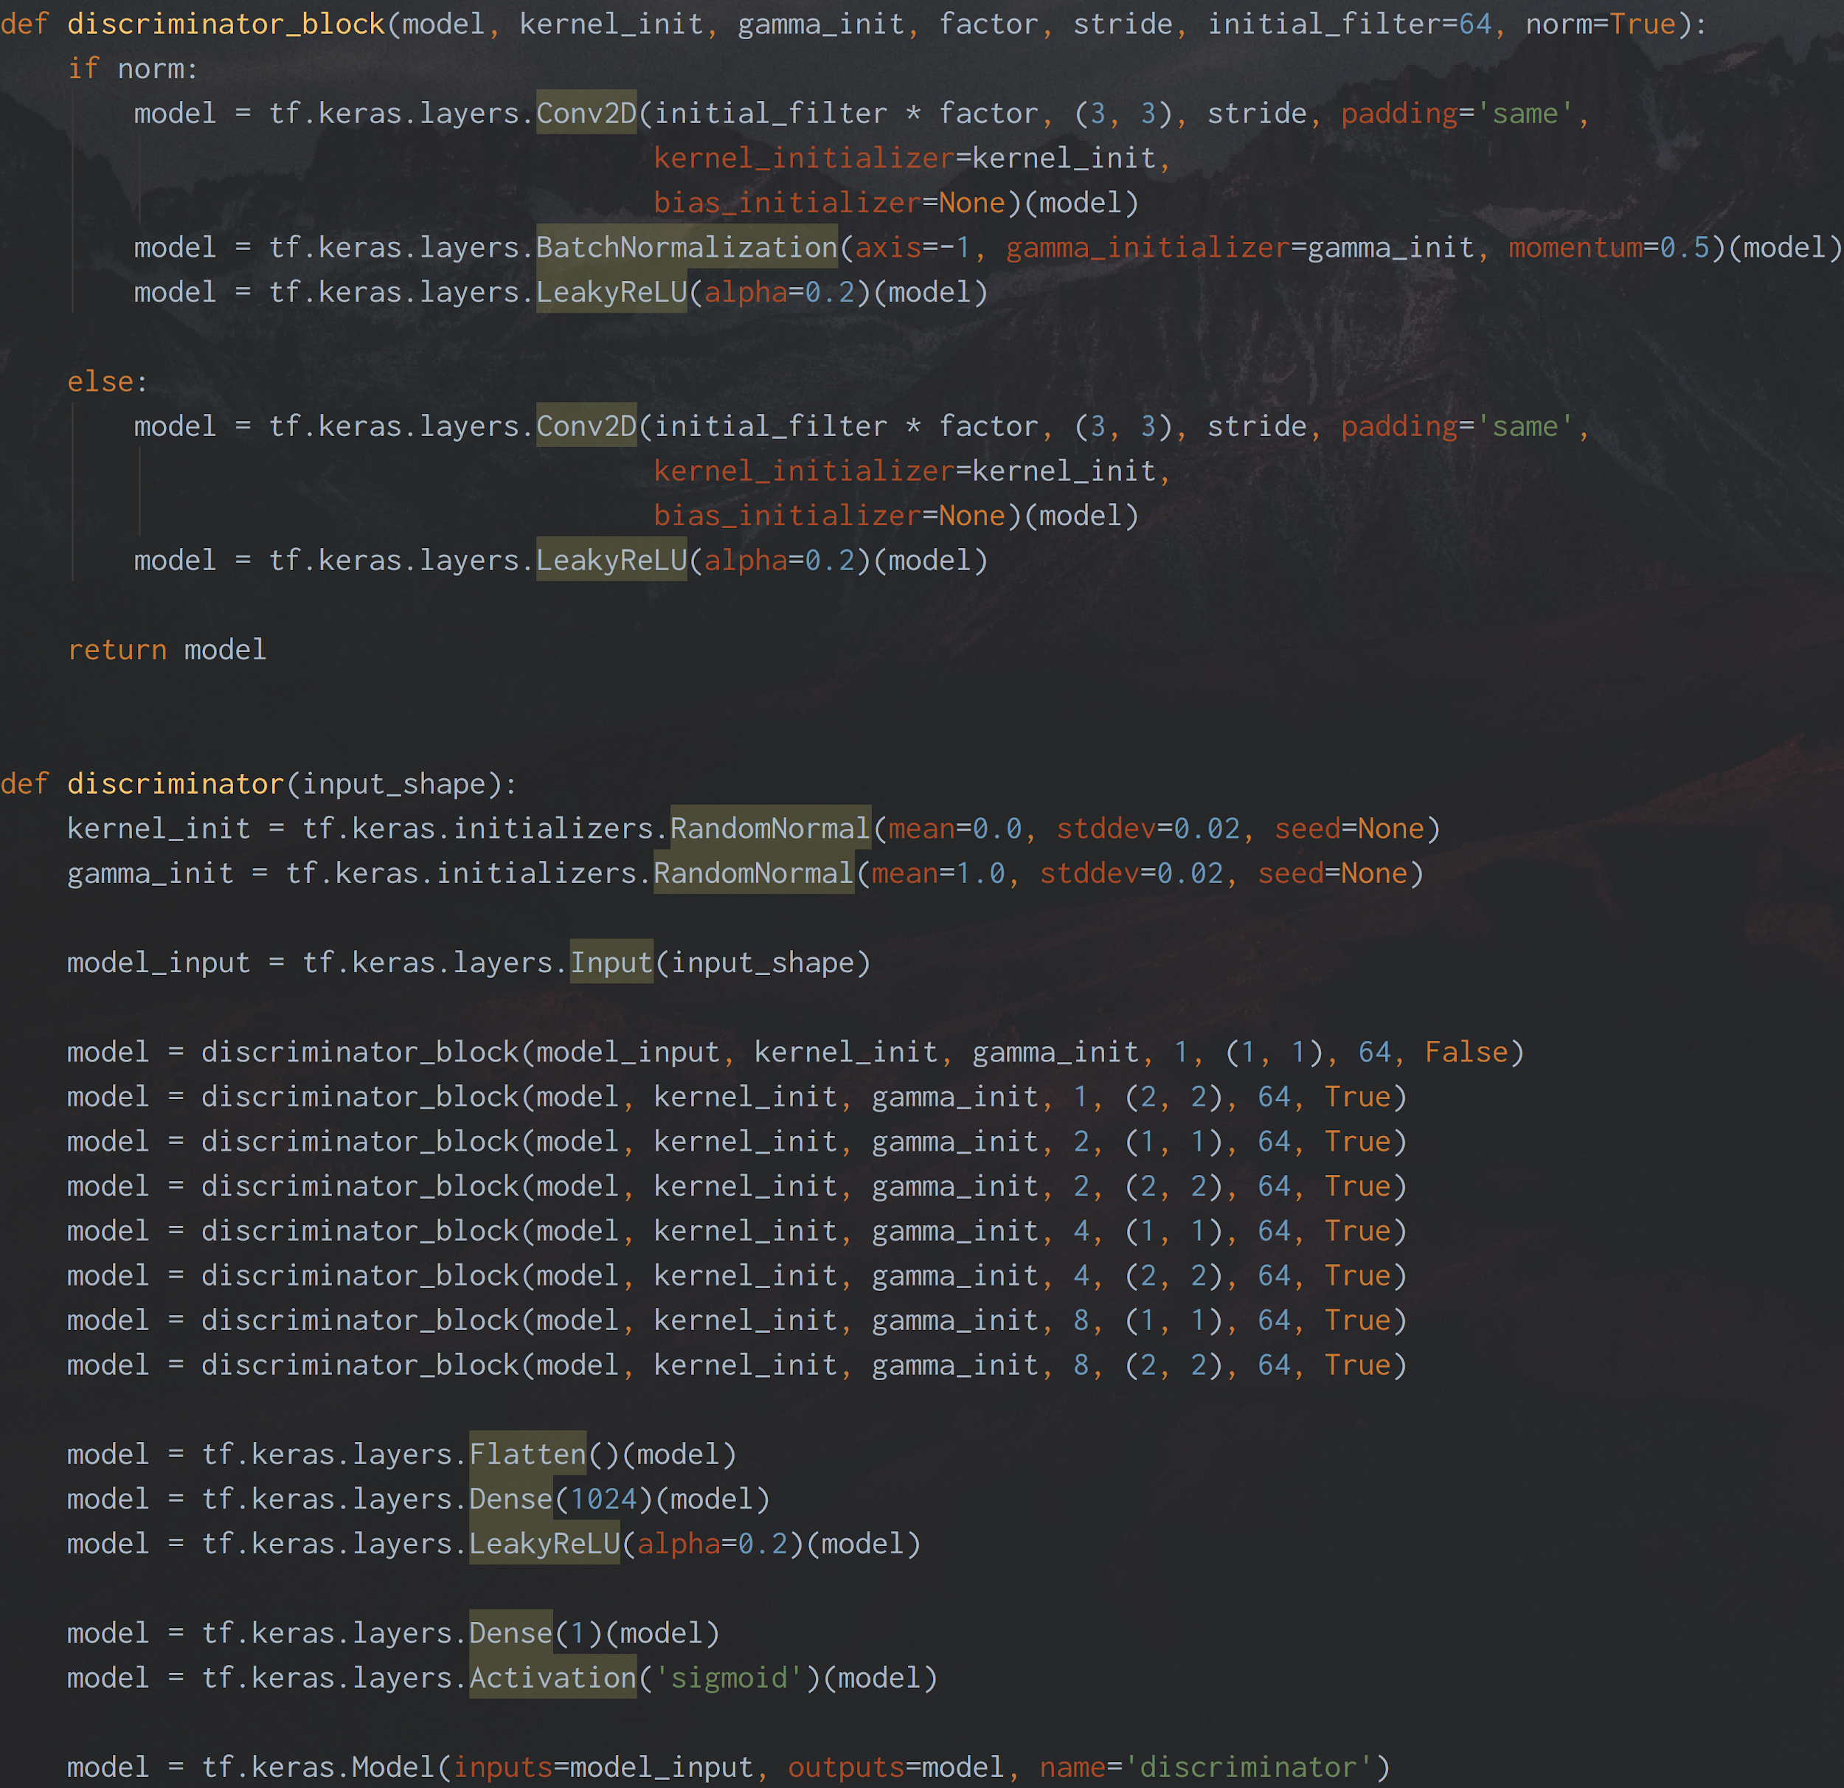
Discriminator Model
Building
13M trainable parameters
Model fed with output of generator and high resolution images

Slide 12
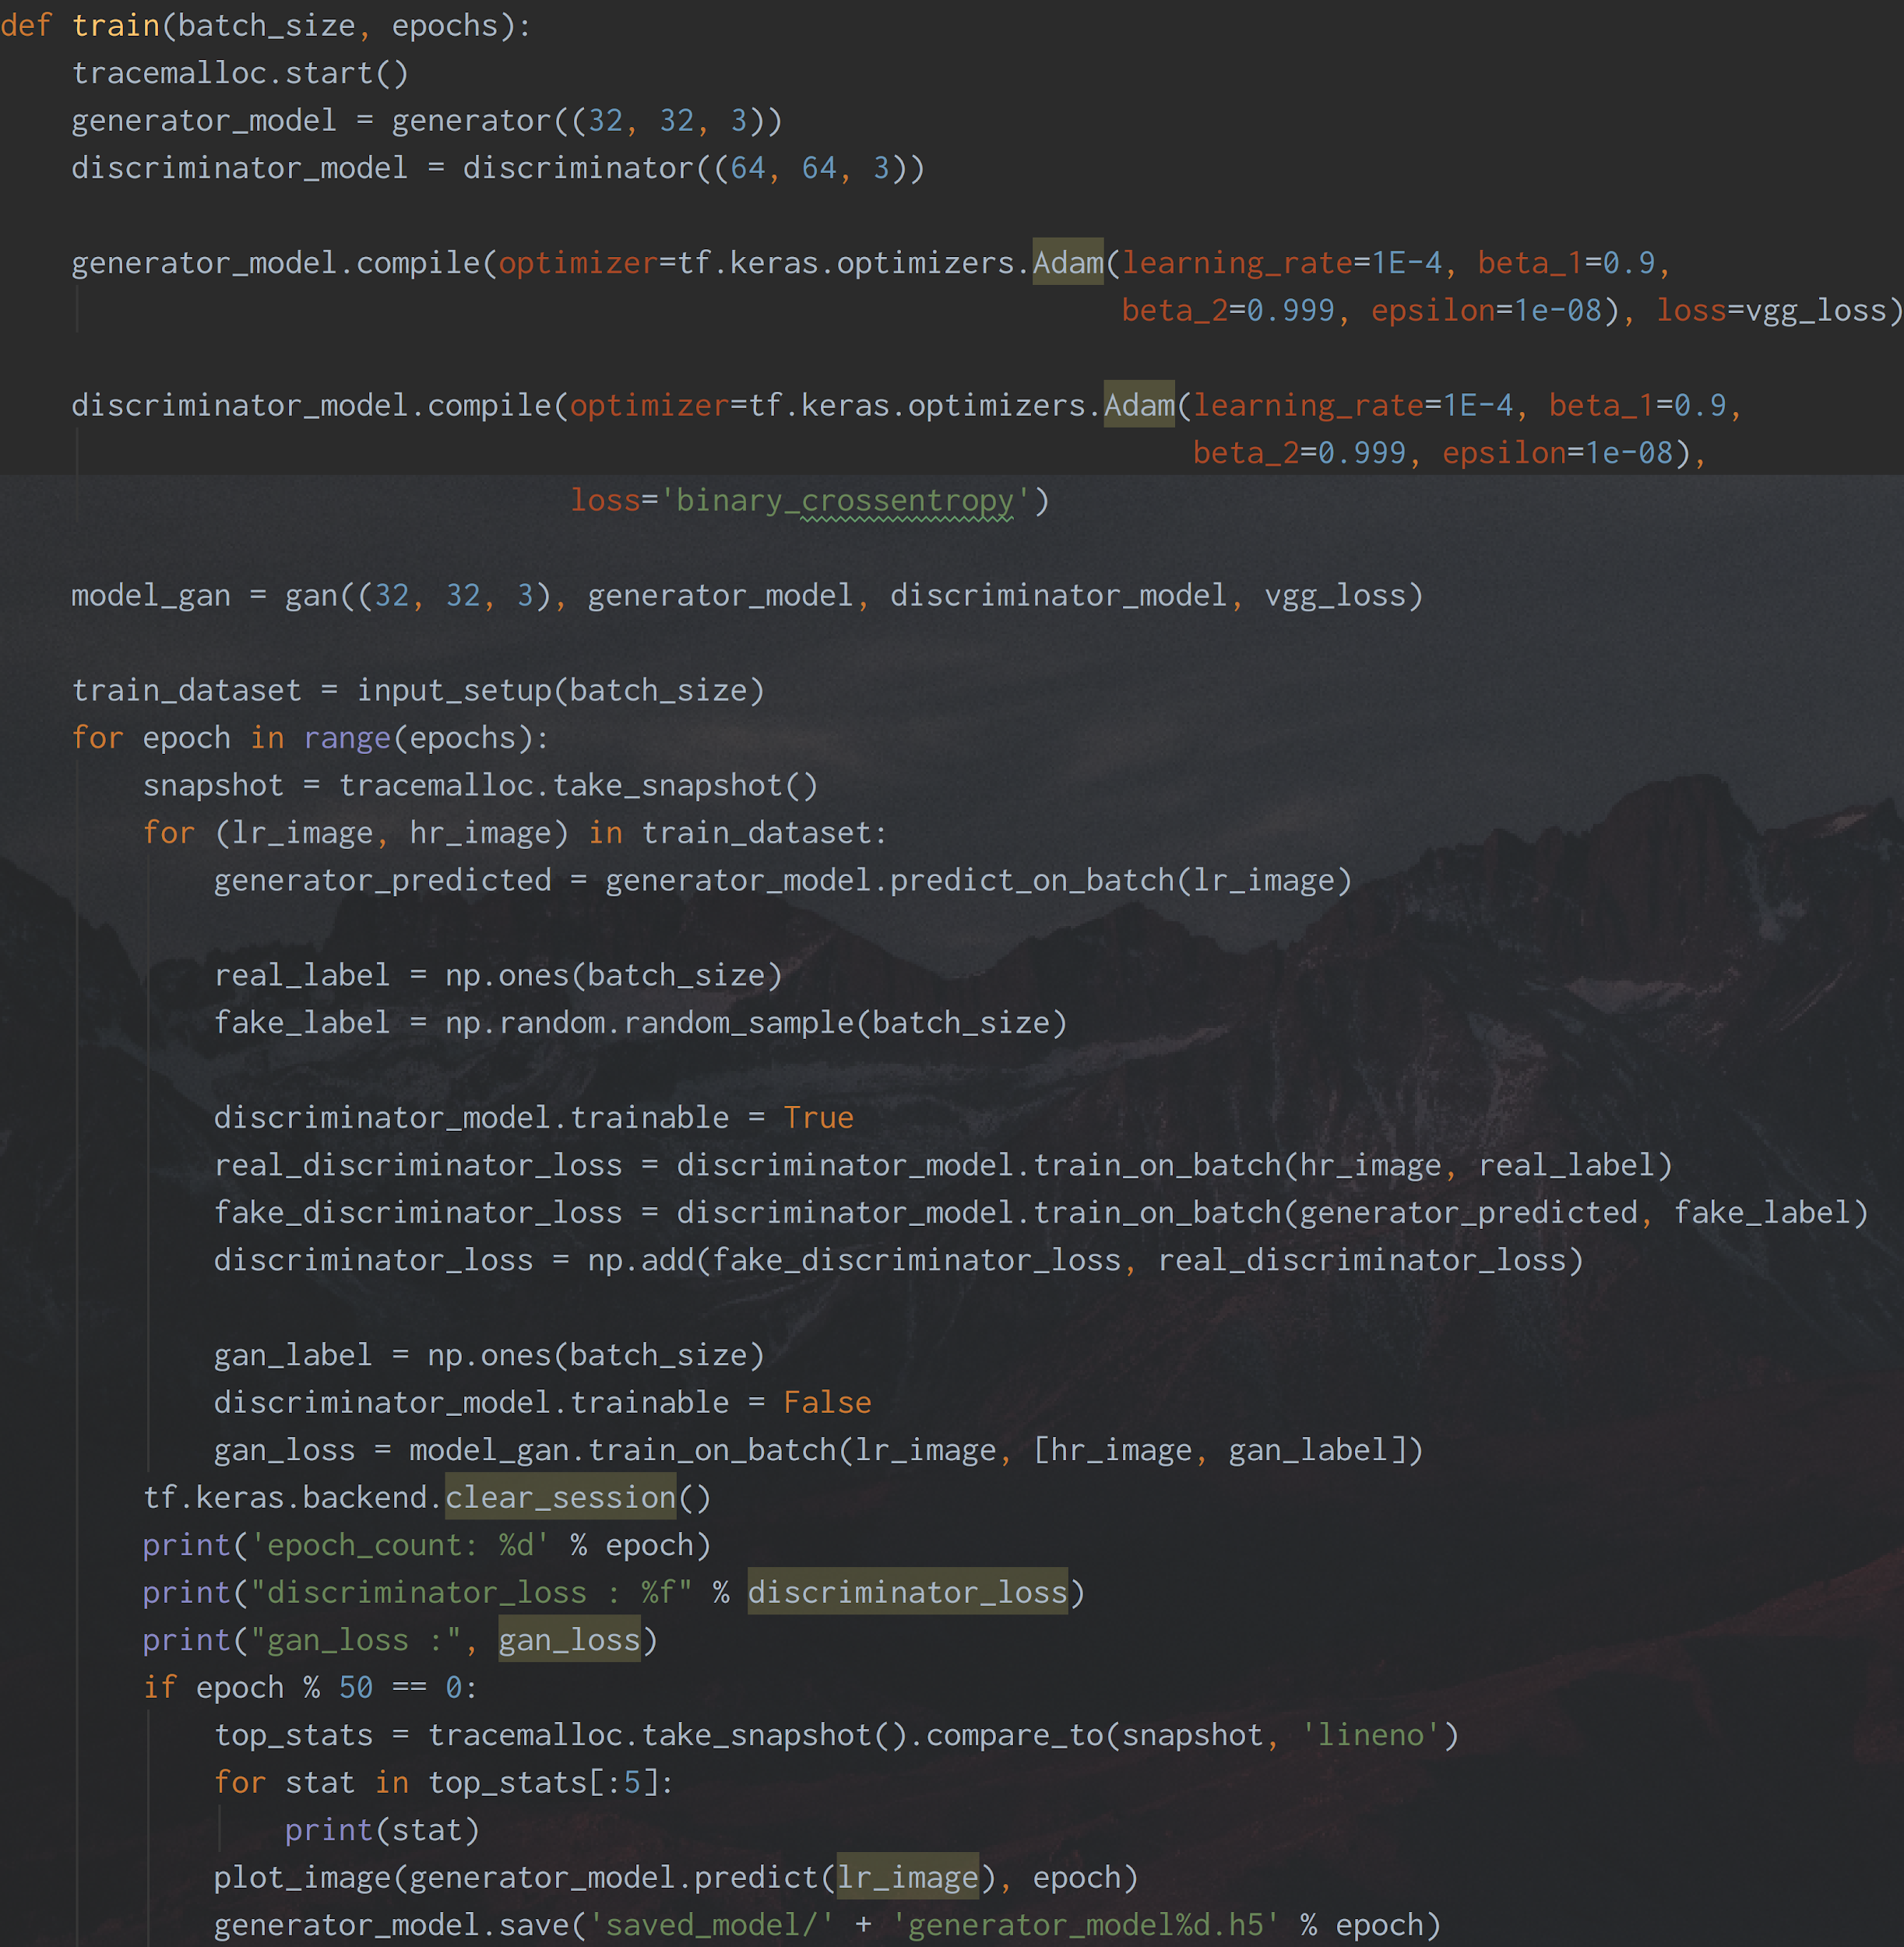
Model Training
Reduction in training size
100 Iterations ~ 12 hours
Model weights saved and reloaded

Slide 13


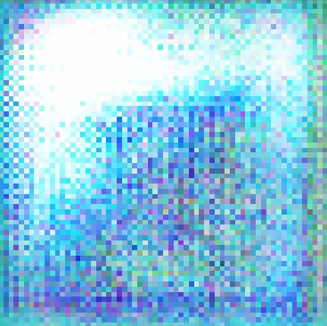
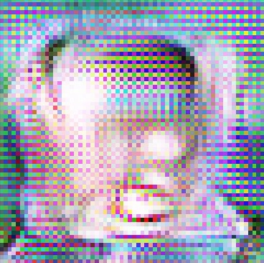
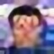
Results and Conclusion
High Resolution Image
Low Resolution Image
Super Resolution Image Iteration 1
Super Resolution Image Iteration 100
Super Resolution Image Iteration 500

